Slide 1
SCOTLAND’S COMMUNITY HERITAGE
CONFERENCE 2015
BAILIES OF BENNACHIE
Commonty, Community and Bennachie
Colin Miller, Jo Vergunst,
Andrew Wainwright
Notes:
Good morning, and thankyou for the opportunity to present something of the work of the Bailies of Bennachie in connection with the northeast’s favourite hill, Bennachie, which sits in the heart of Aberdeenshire and conveys a sense of place to folk from twenty miles around. Jo Vergunst, Andrew Wainwright and myself will each speak for a few minutes – Jo on recent work involving oral history, Andrew on his research into a particular feature on the hill, and in my presentation just now I’m looking at events on Bennachie in the past 150 years, how they reflect and relate to the community heritage scene at national level past, present -- and beyond.

Slide 2
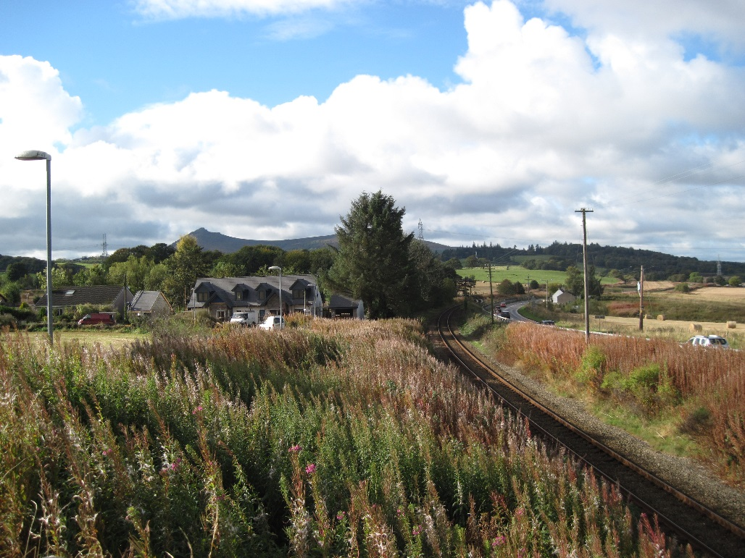
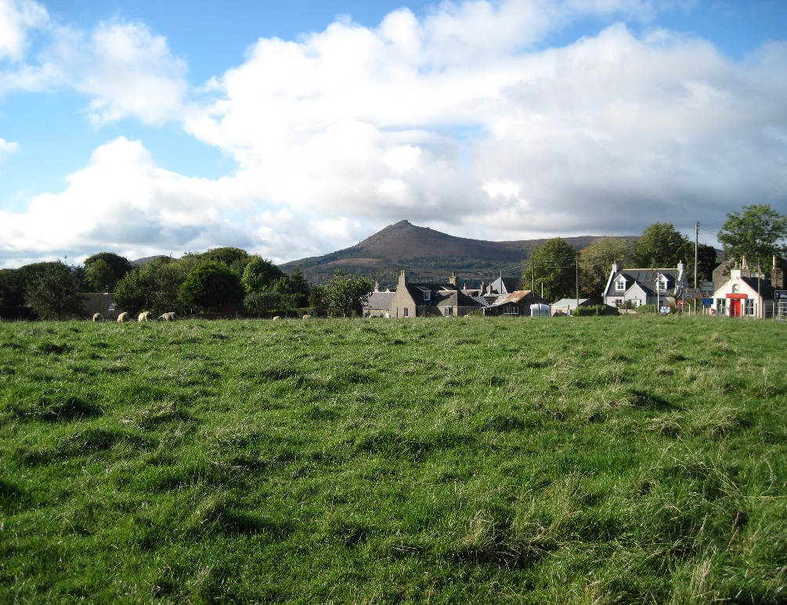
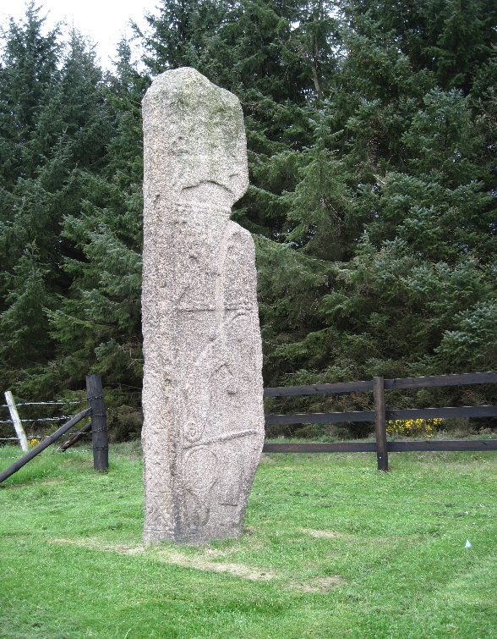
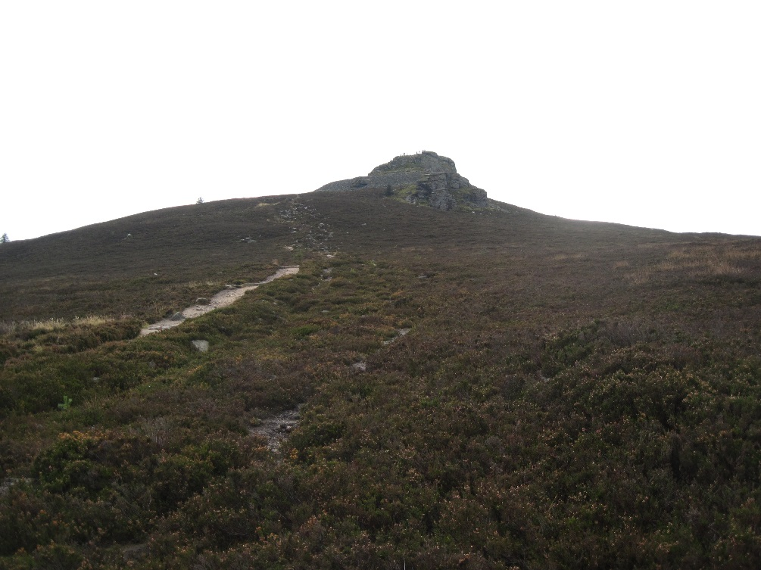
Aberdeen United Trades Council
23 Sept 1889
Demonstration on Bennachie
Notes:
We go first to Pitcaple, once a station on the Great North of Scotland Railway, 21 miles northwest of Aberdeen. It is mid-morning on the 23rd September 1889, and a special train from Aberdeen has just disgorged 500 passengers onto the platform. Refreshments are taken, and the throng heads for the Mither Tap of Bennachie, walking via Chapel of Garioch (centre of the parish), the Pictish Maiden Stone standing at the roadside, and up the rough mountain path to gather near the hill fort on the Mither Tap itself. Joined by around 100 other folk from the neighbourhood, pipers play, speeches are delivered and a picnic is enjoyed. The occasion has been organised by Aberdeen United Trades Council, which represents the various embryonic trades unions in the city and surrounding areas. In the next few minutes I’d like to explore the origins of this extraordinary gathering and how events on and around Bennachie relate to the national picture then – and now.

Slide 3
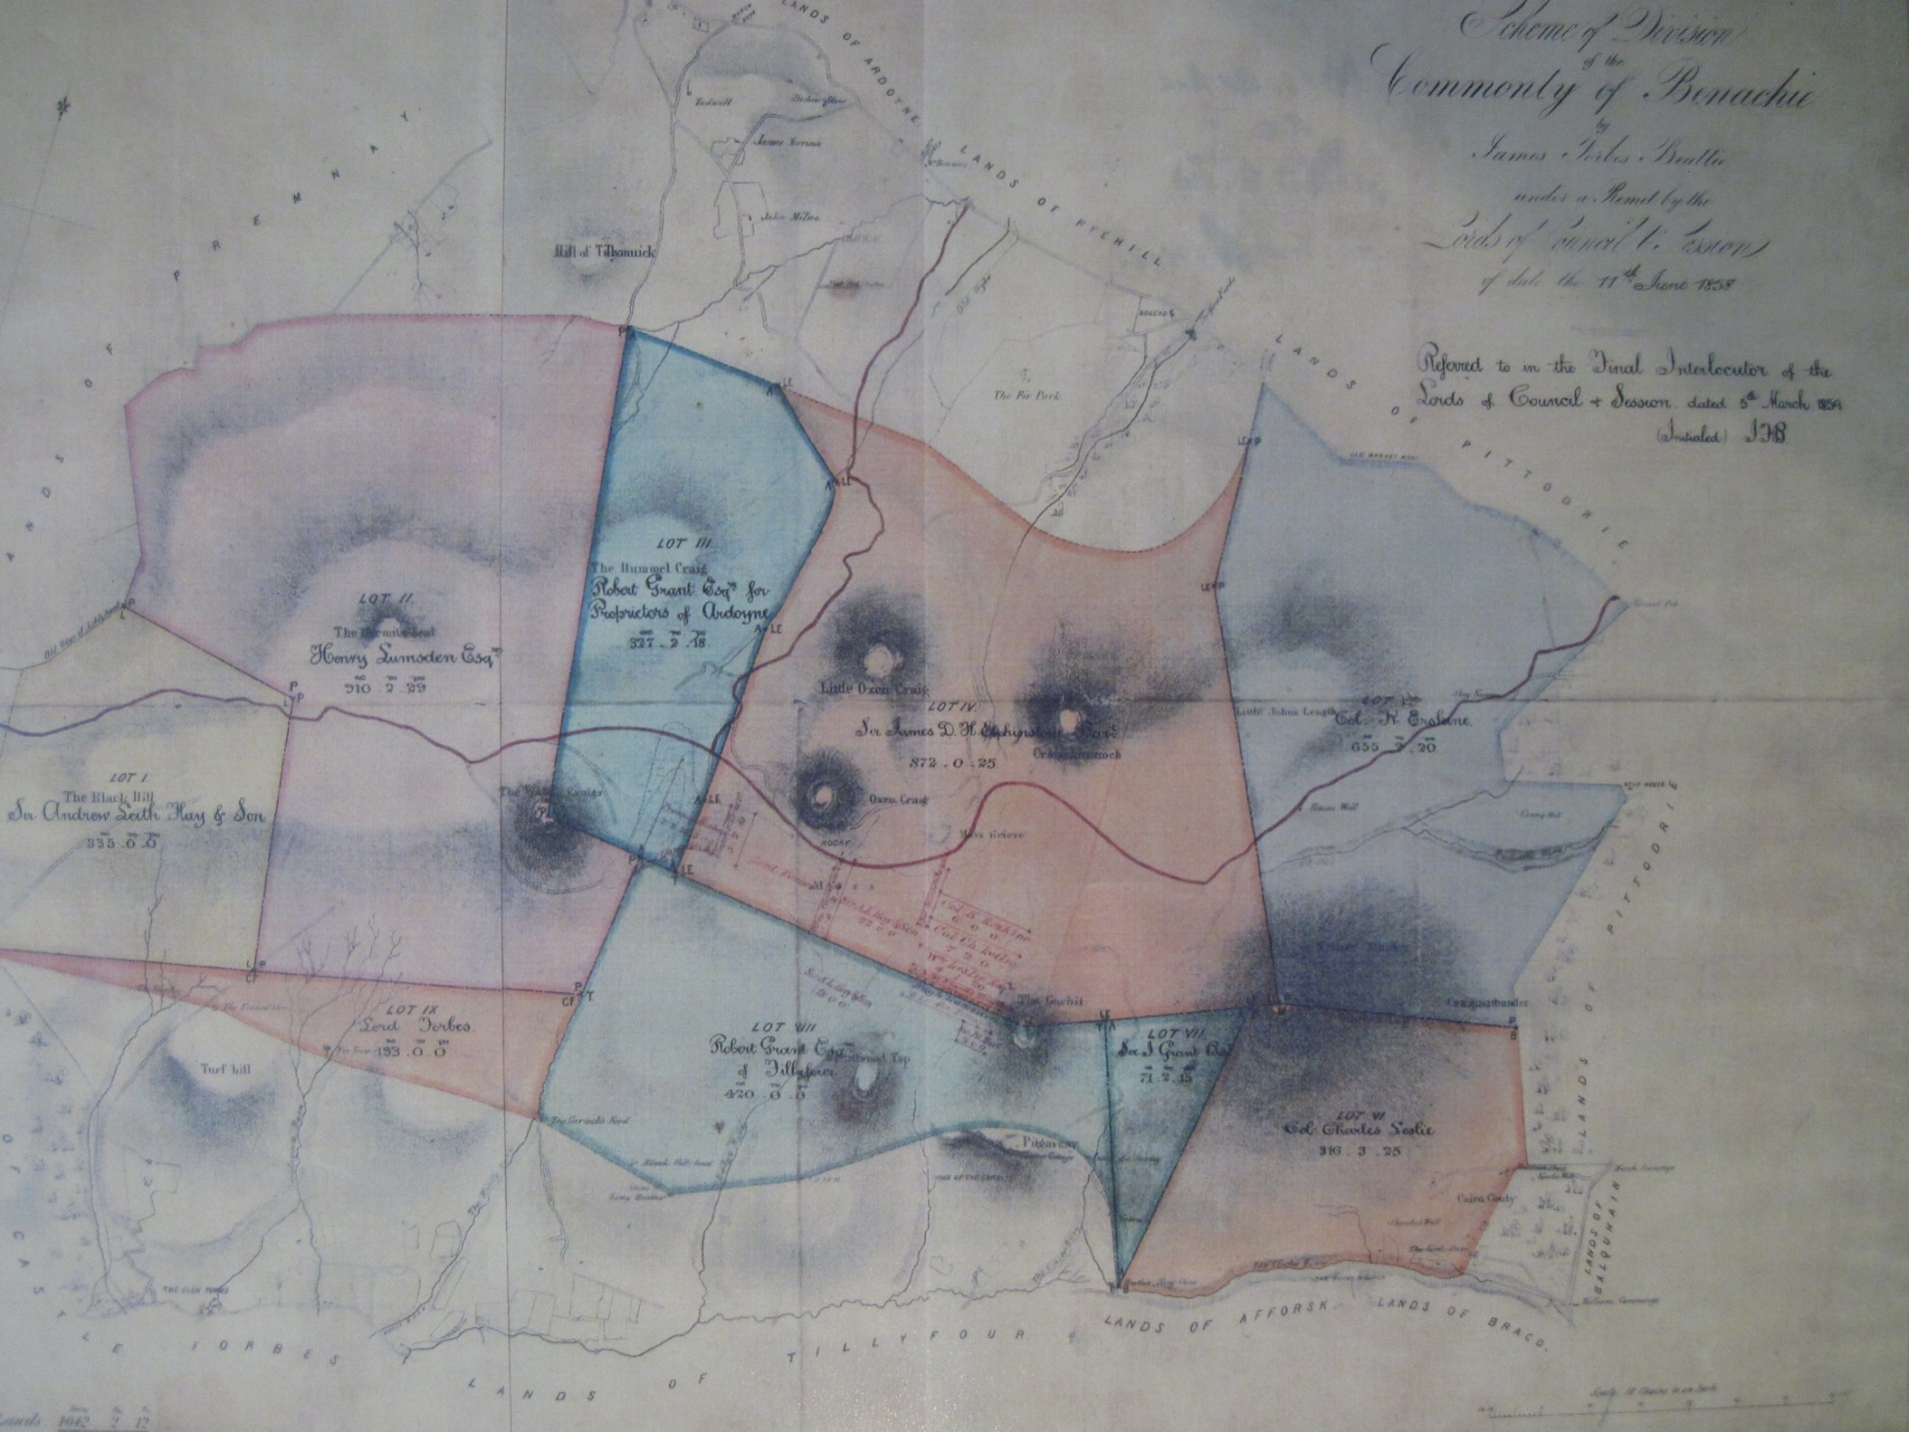
Notes:
This rather beautiful map shows the “Scheme of Division of the Commonty of Benachie” which took place in 1859 according to due legal process, underpinned by an Act of the Scottish Parliament of 1695. Commonty is the undivided common property of a number of landowners, and although it was not therefore a public cpmmon in the accepted sense, it was widely perceived to be so. Consequently surrounding communities saw this significant event as something approaching theft. Indeed only last year a local man in his 80s said to me “xxxxxx”. On the map, a portion of the commonty (SHOW) was assigned to Col. Charles Leslie of Balquhain and Fetternear (CUE FTN slide)…

Slide 4
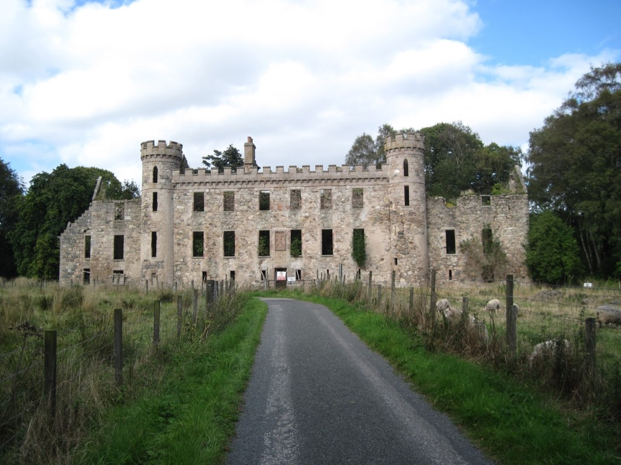
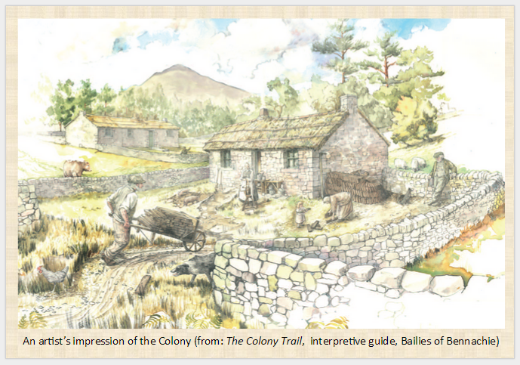
Fetternear Mansion
A Colony cottage
(artist’s impression)
Notes:
Charles Leslie’s mansion contrasts dramatically with the crofters’ cottages, but the heating costs must have been enormous! Although we must not romanticise their situation, the colonists on Bennachie, meanwhile, had peat from the hill and insulated roofs, food from crops and livestock, and probably part-time work on local farms and estates. Initially they were independent squatters, in a legal sense, but at a stroke the Division of the Commonty gave Col. Leslie the power to impose rents on them. Although the standard tenancy conditions seemed harsh, it has to be said that the actual rents appear to have been reasonably proportionate to the size of the crofts, and it would appear that as long as the rents were paid the crofters were allowed to remain on their holdings.

Slide 5
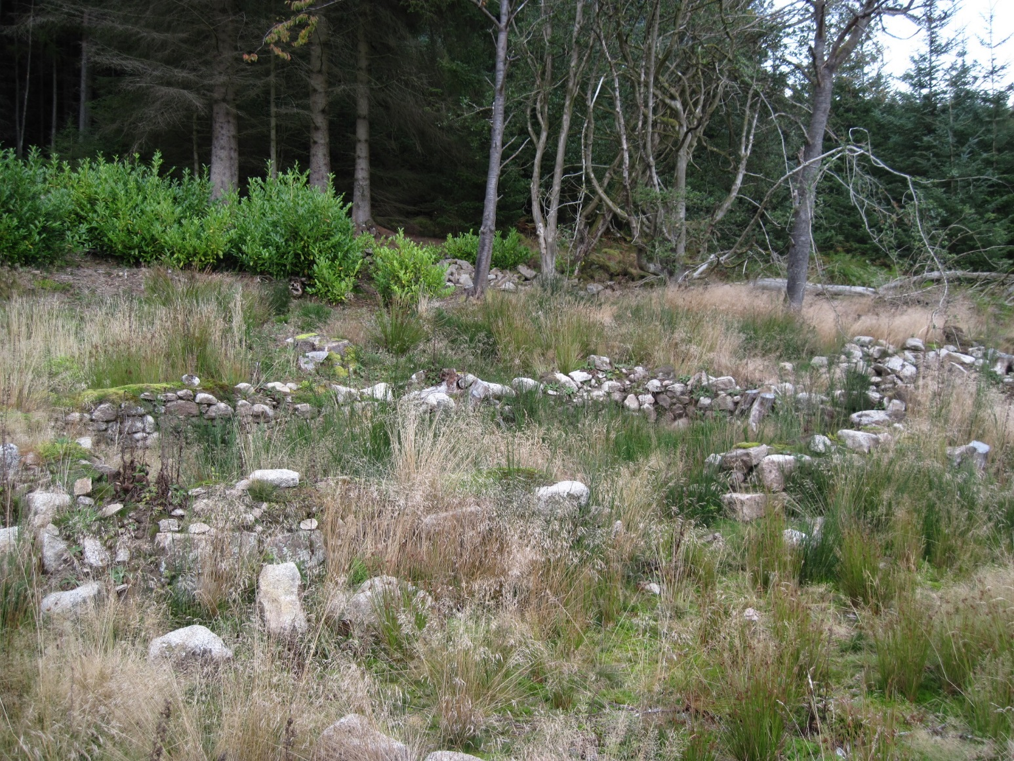
“He had spent the best five-and-twenty years of his life in making a home to his family, but the lairds had left him outside to starve or drown his children,”
Hugh Littlejohn, Shepherd’s Lodge. The Aberdeen Journal, 24 September 1889.
Notes:
The crofting population dwindled over the years following the Division, and in 1878 three households were in serious arrears of rent. Sheriff’s Officers were called to Shepherd’s Lodge, where the two Littlejohn households were evicted and the houses destroyed. Only a few courses of stones survive today. Eleven years later, one of the evicted crofters, Hugh Littlejohn, addressed the gathering on Bennachie. In his speech he contrasted the independence of life on Bennachie with the deprivations of living in the city to which he had been forced to move. Hugh Littlejohn’s speech at the Gathering brings together in one event the parallel grievances which have come down through the years, namely displacement of the resident population from the land and denial of public access.
From the landowners’ perspective, Bennachie offered more potential income than crofting rents could provide. Much of the former crofting land was planted with trees, while the higher moorland was managed as grouse moor – here we have a resonance with the more well-known Highland clearances, where a sporting economy displaced the indigenous population.

Slide 6
Why so much popular feeling?
Division of the Commonty
Railway “excursionists” 1860s
Cosmo Innes 1872
Scottish land unrest 1880s
Henry George 1884 -- proponent of land value tax
Aberdeen United Trades Council – land reform; “right to Bennachie”
James Bryce MP (South Aberdeen) “Access to Mountains (Scotland)” Bills 1884-early 1900s
Notes:
Divn of Commonty resulted in rents being imposed; and public perception of theft of common resource. Only last year (2014) a local man in his 80s put it to me that “the landowners stole the Commonty – whatever that may mean” -- I think he was waiting to see what I would say, but his words do reflect a lingering popular sense of injustice. Whatever the rights and wrongs, the laird in his castle could not have been the favourite person of the poor man in his cottage on Bennachie.
BAC excursionists 1864 Bfsh Jrnl & Aberdeen Journal–railways -- tension – fires; disturbance of grouse moors; outdoor access & recreation.
“Johnny Gibb of Gushetneuk” 1871 – although largely concerned with the church’s Disruption of the 1840s, William Alexander’s writing presents an uncomplimentary view of the lairds of the day. Explicit Bennachie connections.
Prof Cosmo Innes 1798-1874 (advocate and historian) in 1872 argues that the landowners’ charters never really included the commons and the landowners’ had never “possessed” them. Highly probable that CI aware of the Bennachie commonty. AW’s book title “The Poor Had No Lawyers” comes from this passage. [NB: CI born at Durris House just west of Aberdeen and not far from Bennachie!] (1872: Pp50-51: AW).
Scottish land unrest 1880s *****[ADD RE HLLRA, CROFTING WARS, CROFTERS ACT ETC]*****
Henry George “American journalist, philosopher and political economist, who was the most influential proponent of the land value tax and the value capture of land/natural resource rents ….. natural resources and common opportunities, most importantly the value of land, belongs equally to each person in a community. Progress and Poverty (1879) – millions of copies worldwide” – advocated land value tax. Does this begin to sound familiar?
AUTC **** quote mins re Land reform support; and “The Right to Bennachie”..***** Add Division investigation and Demo organisation
Professor James Bryce -- it is highly probable that JB was aware of the history and events at Bennachie.***** TBC by ref to AUTC mins dates Quote dates re contact with JB*****

Slide 7
20th century - Chapter 1
James Bryce’s and subsequent Bills failed
Forestry Commission buys Bennachie land (from 1938)
Car ownership increase
1973 Bailies of Bennachie formed
Notes:
Reasons for ATM bills’ failure ***** but Bryce’s efforts continued to be quoted in Parliament and by access advocates through to the present day.
Increase in car ownership – similar effect to the railways of a century before.
Common feature of the 20th-century developments listed was lack of recognition of communities per se.
FC initially timber focus

Slide 8
Preserve the amenity of the hill and its environs
Help maintain and improve paths
Conserve the natural and cultural assets
Encourage responsible public engagement with the hill
Notes:
A key partner in the Project is the Bailies of Bennachie which was founded in 1973, and is now a registered charity dedicated to conserving the cultural and natural history of the hill. The current membership is almost 3000 spread throughout Britain and among the diaspora across the world; with of course a good core of support in the north-east of Scotland. Currently the Bailies are in discussion with Aberdeenshire Council in a bid to achieve a planning designation to protect the landscape of Bennachie.

Slide 9
20th century - Chapter 2
Lottery funding 1994
Community Land Unit (HIE area)
First major community land purchase 1993
Scottish Parliament 1999
Scottish Land Fund 2001
Land Reform (Scotland) Act 2003 -- rights of responsible access;
-- community right to buy.
Land Reform (Scotland) Bill – (Stage 1 2015)
Community Empowerment (Scotland) Act 2015
Notes:
First major community land purchases
e.g. Assynt; Isle of Eigg – took place well before legislation supporting communities, but it is now established that these buyouts have succeeded in boosting the self-confidence of communities and reinforcing peoples’ sense of belonging to a place.
LRSA – much input from Aberdeenshire Council and many other planning authorities re public access; RTB found to be complicated, with limited take-up.
Community begins to appear in establishment terminology.

Slide 10
Land Reform (Scotland) Bill
Preparation of “land rights and responsibilities statement”
Scottish Land Commission – monitor land law and policy
Right of access to information about owners of land
Provision of guidance about engaging communities in decisions relating to land
Eligible community bodies and others to have a right to buy land for sustainable development
Simplified procedure for change of use of common good land
Notes:
Checked sp website for updates 8/11/15. At Stage 1; no schedule yet given for further stages.
Part 1 proposes that the Scottish Government prepare a land rights and responsibilities statement and publish it within 12 months; Ministers must review this, and subsequent statements within five years.
Part 2 provides for the creation of a Scottish Land Commission to e.g. review the impacts and effectiveness of land law or policy, and to recommend changes to these; as well as to gather evidence and conduct research. The Land Commission will consist of a total of 6 members – 5 Land Commissioners and a Tenant Farming Commissioner.
Part 3 provides for a right of access to information about persons in control of land for interested parties, as well as a power for the Keeper of the Registers of Scotland to request information relating to proprietors of land.
Part 4 requires Ministers to “issue guidance about engaging communities in decisions relating to land which may affect communities”. In preparing this, regard must be paid to “the desirability of furthering the achievement of sustainable development in relation to land”.
Part 5 provides for a right to buy land to further sustainable development for eligible Community Bodies (or a third party purchaser).
Part 6 ends business rate exemptions for shootings and deer forests by including them on the valuation roll so that they are identified and valued by the Assessors.
Part 7 amends the Local Government (Scotland) Act 1973 so that local authorities can change the use of inalienable common good land with court approval, without the need to pass a private bill in the Scottish Parliament.
Part 8 makes a minor technical amendment to the Deer (Scotland) Act 1996 as well as introducing a power to require landowners and occupiers to prepare deer management plans subject to certain conditions.
Part 9 makes minor technical amendments to the Land Reform (Scotland) Act 2003 in relation to reviewing and amending core paths plans, and judicial determination of the existence and extent of access rights and rights of way.
Part 10 is extensive and introduces substantial amendments to both the Agricultural Holdings (Scotland) Act 1991, and the Agricultural Holdings (Scotland) Act 2003. These are: the creation of a modern limited duration tenancy; the removal of the requirement for a tenant to register their interest in purchasing their holding under existing right to buy provisions; enabling a tenant to apply to the Scottish Land Court to order the sale of their holding where the landlord persistently fails to meet their obligations under certain circumstances; simplifying and improving the process for triggering and carrying out a rent review for certain tenancies; widening the class of people to whom a tenant farmer can assign or leave their tenancy upon death; providing for an amnesty period whereby certain tenants can serve a notice on their landlord detailing improvements that have been made that they would like compensation for on departure; and providing a right for tenants to object to certain improvements proposed by the landlord if they are considered unnecessary.

Slide 11
Community Empowerment (Scotland) Act 2015
to amend Parts 2 and 3 of the Land Reform (Scotland) Act 2003
to enable certain bodies to buy abandoned, neglected or detrimental land
to make provision for registers of common good property and about disposal and use of such property
Notes:
This is improving the balance between property rights and community interests, with potential environmental benefits too. Although needed, it is well to note that much can be achieved through voluntary, common-sense cooperation between landowners and the wider community, e.g. the Bennachie Landscapes Project (CUE SLIDE).
***How does it simplify RTB?*****
An Act of the Scottish Parliament to make provision about national outcomes; to confer functions on certain persons in relation to services provided by, and assets of, certain public bodies; to amend Parts 2 and 3 of the Land Reform (Scotland) Act 2003; to enable certain bodies to buy abandoned, neglected or detrimental land; to amend section 7C of the Forestry Act 1967; to enable the Scottish Ministers to make provision about supporters' involvement in and ownership of football clubs; to make provision for registers of common good property and about disposal and use of such property; to restate and amend the law on allotments; to enable participation in decision-making by specified persons having public functions; to enable local authorities to reduce or remit non-domestic rates; and for connected purposes.

Slide 12
Bennachie Landscapes Project
A collaboration between the Bailies of Bennachie and the University of Aberdeen in conjunction with landowners and community volunteers
Notes:
Meaning of the words “community” and “heritage” are open to endless discussion, but various languages have words with which we can identify:
Duthchas (“doochus”) – native land; dualchas – heritage.
And in the country of Bennachie – (h)Airschip – inheritance.
I hope I’ve helped to show how the history of Bennachie has been influenced by, and may itself have influenced, events and developments on the wider national scale -- demonstrating that individual community heritage initiatives are usually not acting in isolation from the bigger national picture – something from which I believe that communities can draw strength and support.
Now… I’ve emphasised the value of recent legislative measures, but we should not forget that constructive cooperation can also offer a way forward in some cases. The Bennachie Landscapes Project, a collaboration between the Bailies of Bennachie and the University of Aberdeen, involving community volunteers and benefitting from the willing cooperation of major landowners. The Project’s aim is to encourage community engagement with the hill. There are many strands to this, one of them being the gathering of oral history, which is my cue to introduce Jo Vergunst on this very topic. Thankyou…

Slide 13
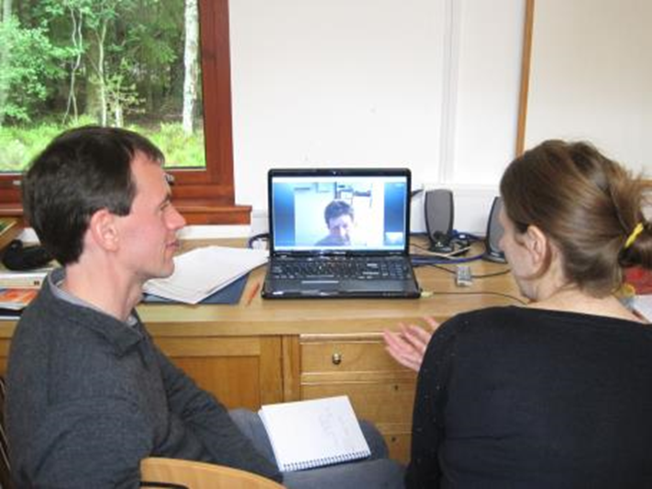
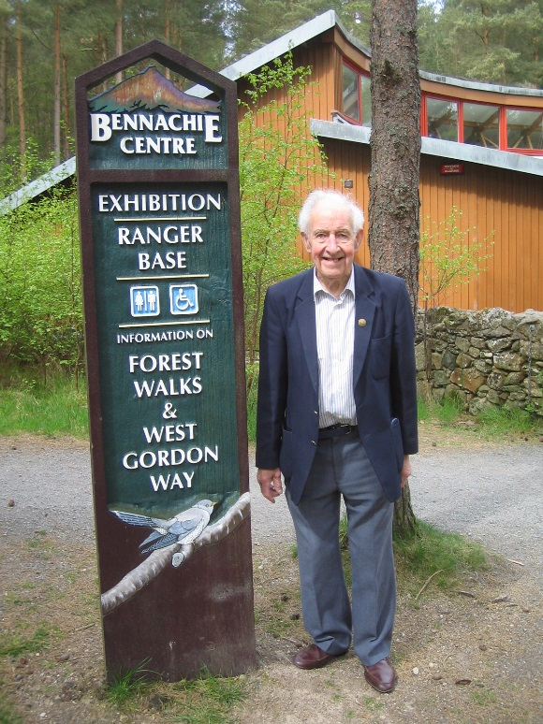
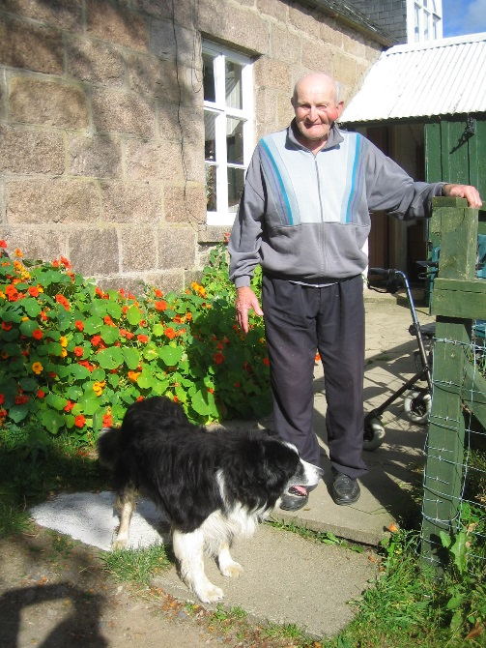
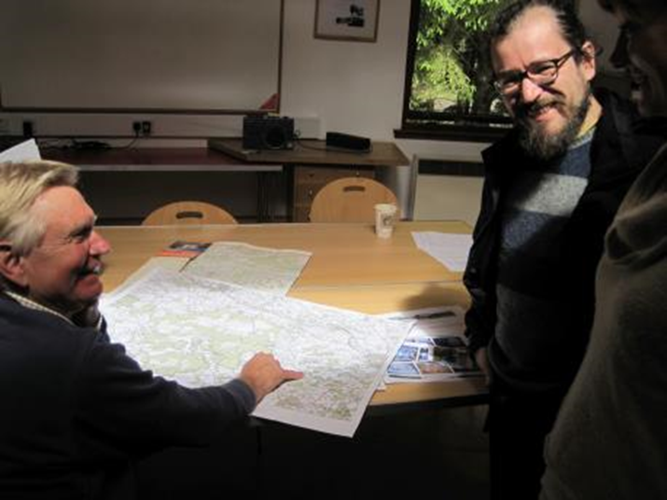
Oral history at Bennachie: changing views of the hill

Slide 14
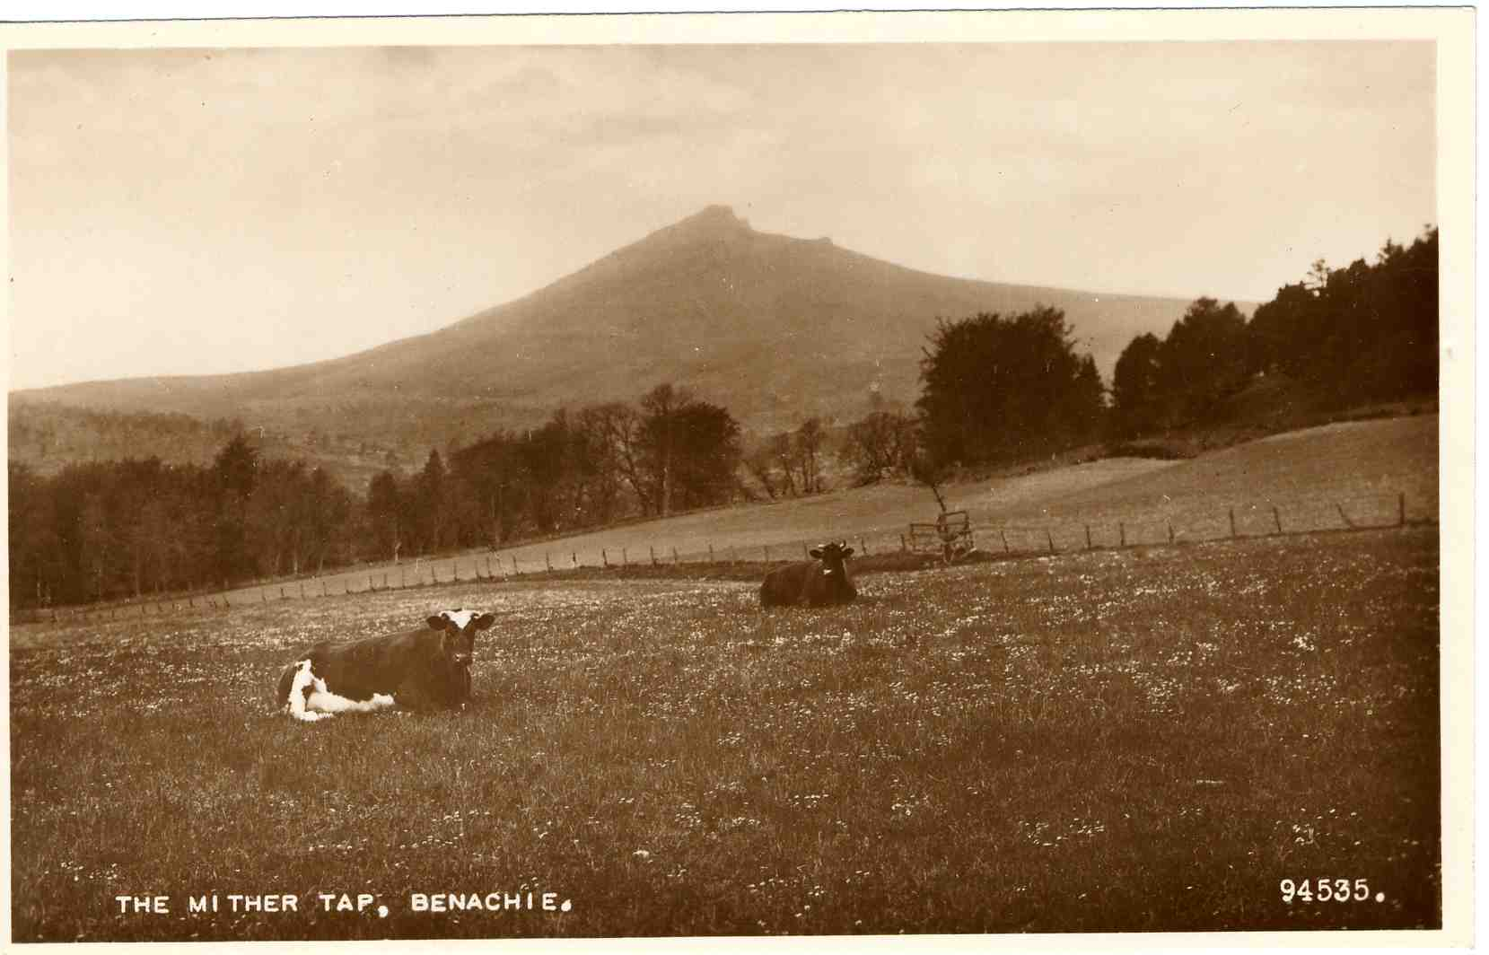
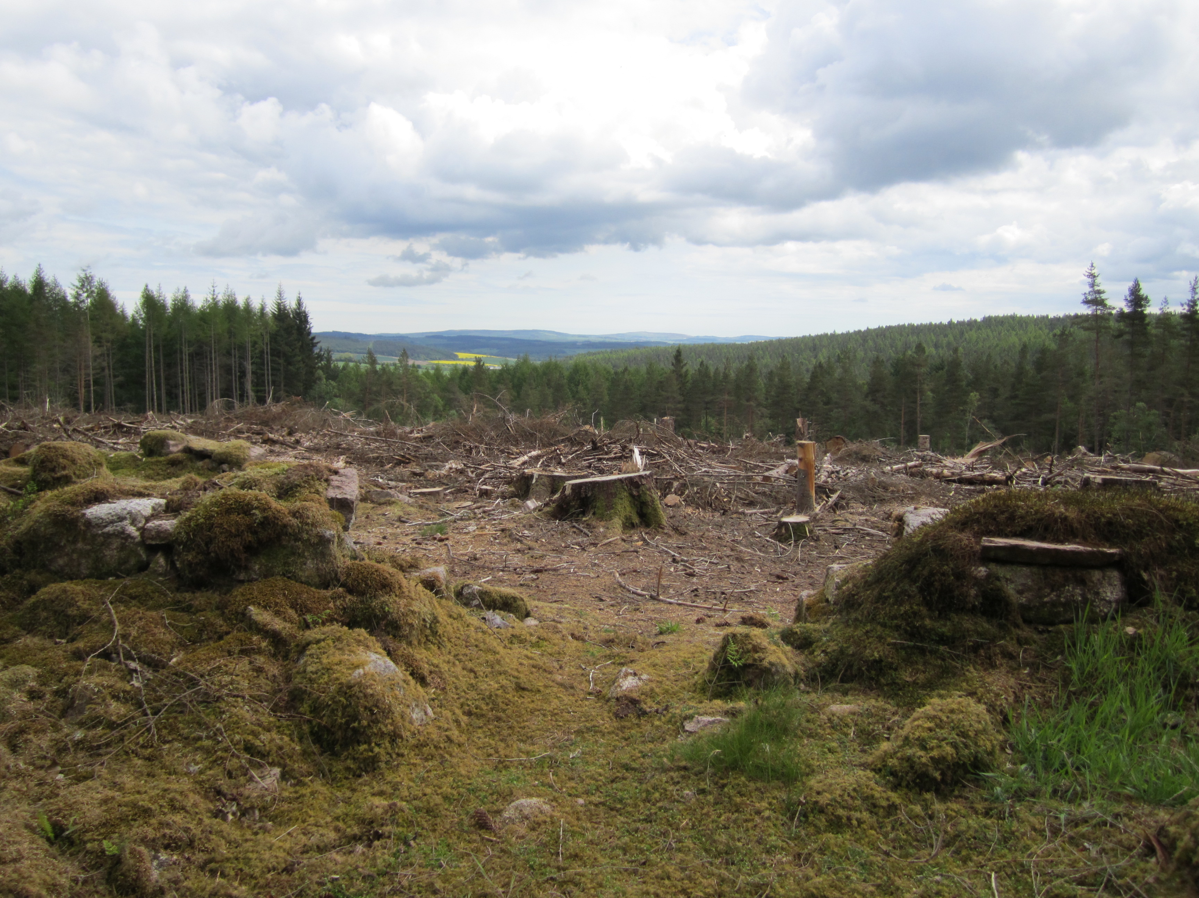

Slide 15
The English Quarry
Andrew Wainwright

Slide 16
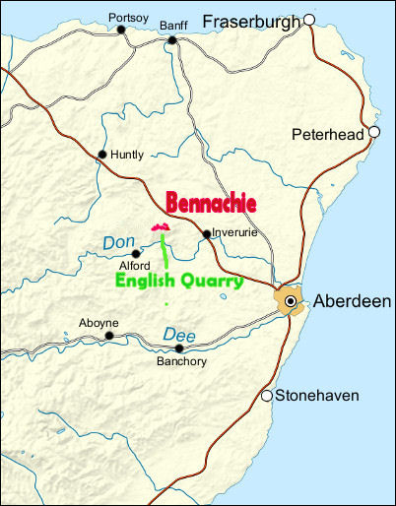
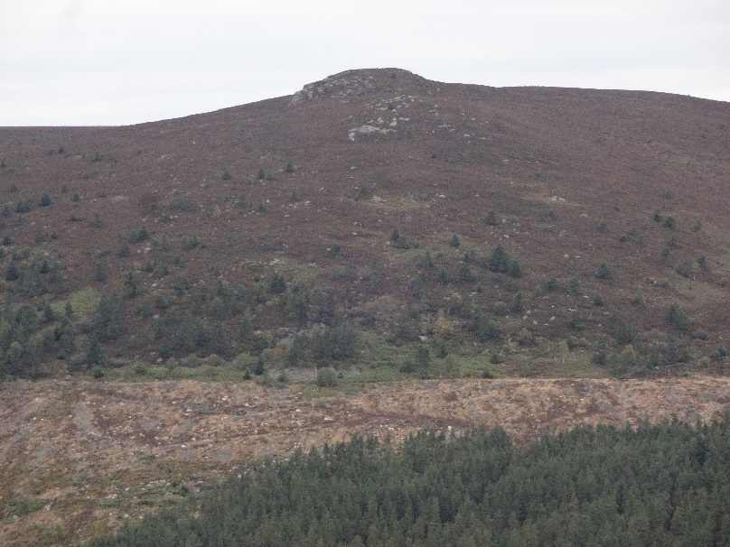
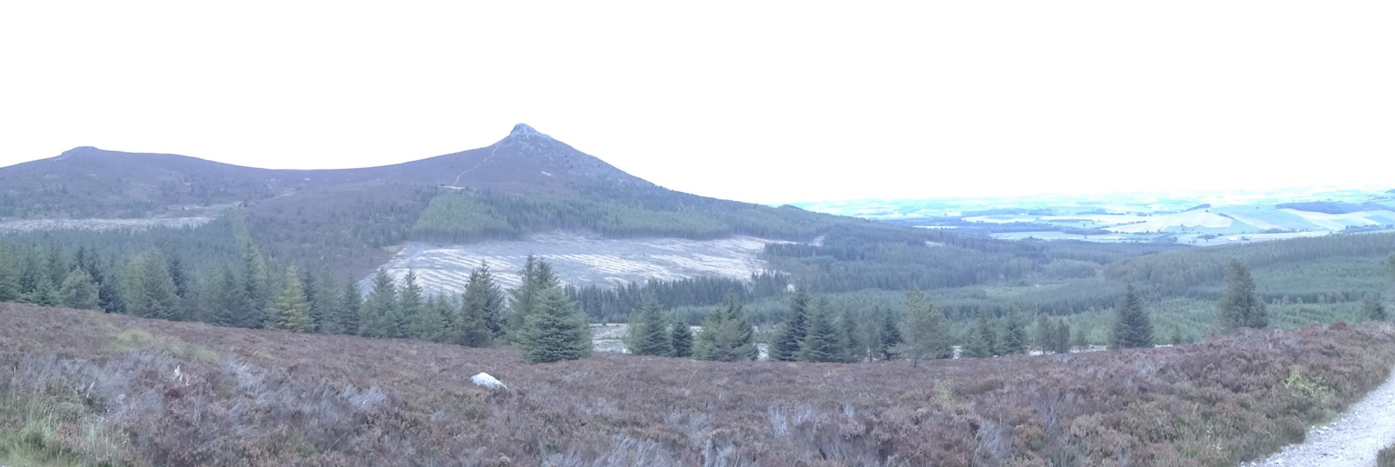
Location
The English Quarry

Slide 17
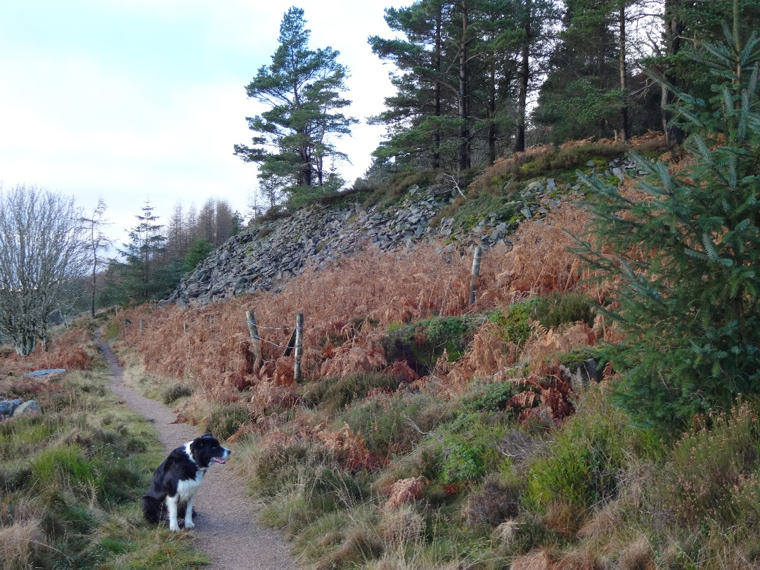
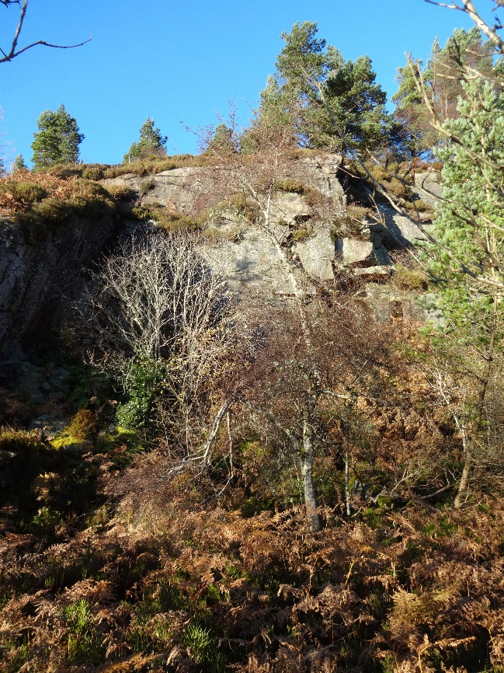
View from Gordon Way
Inside the quarry

Slide 18
History
McConnachie (1890): “upwards of seventy years since the quarry ceased to be worked.”
Sheerness Naval Dockyard: 1813-1823
Inverurie Canal: 1805-1854

Slide 19
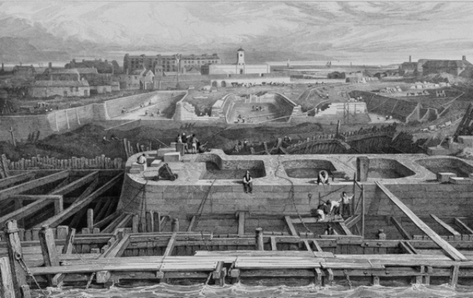
Sheerness docks under construction c.1810

Slide 20
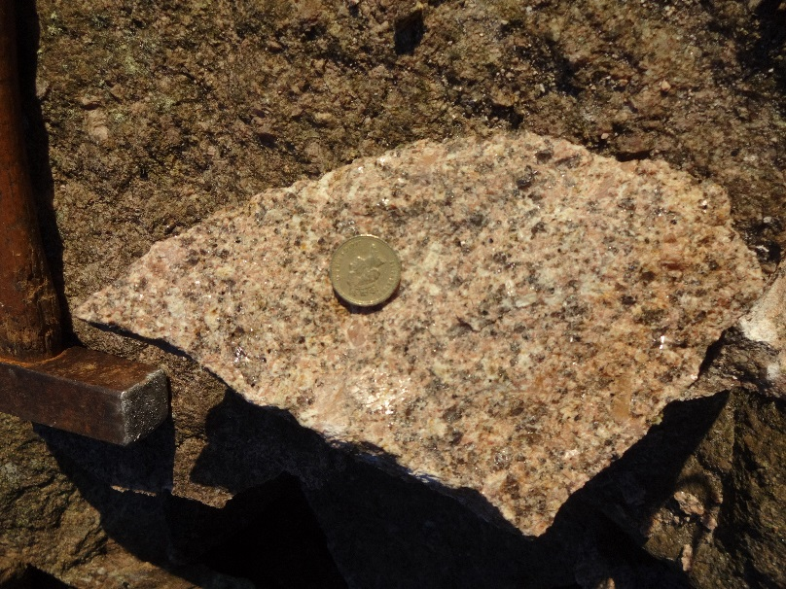
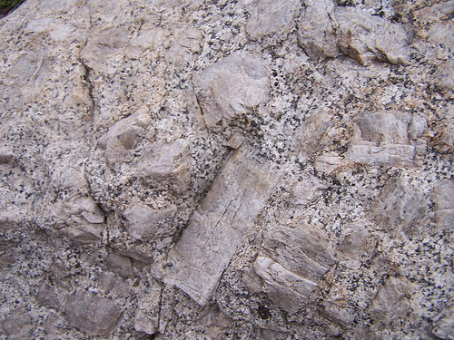
Petrology
The Bennachie granite is a porphoritic biotite granite.

Slide 21
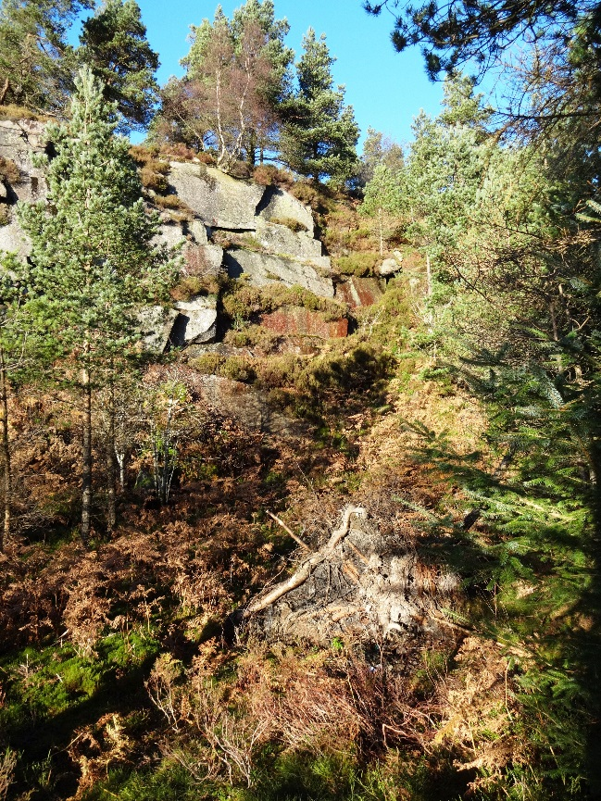
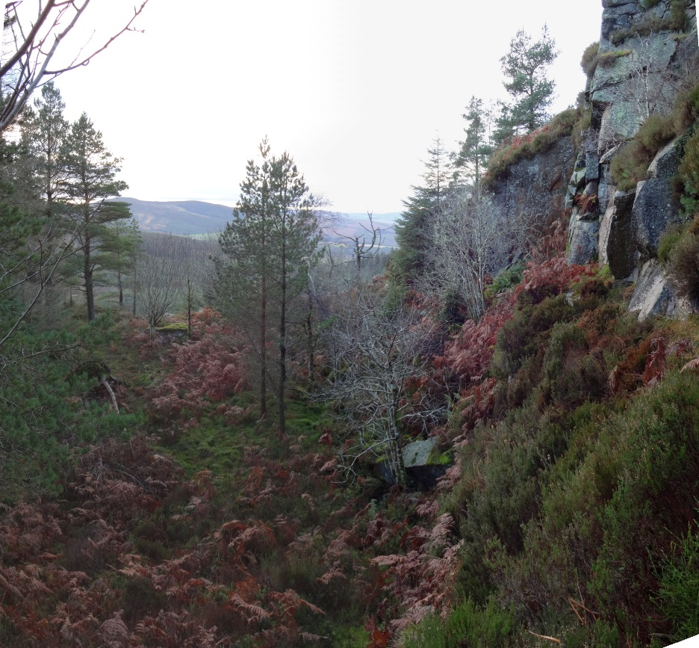
Views inside the quarry

Slide 22
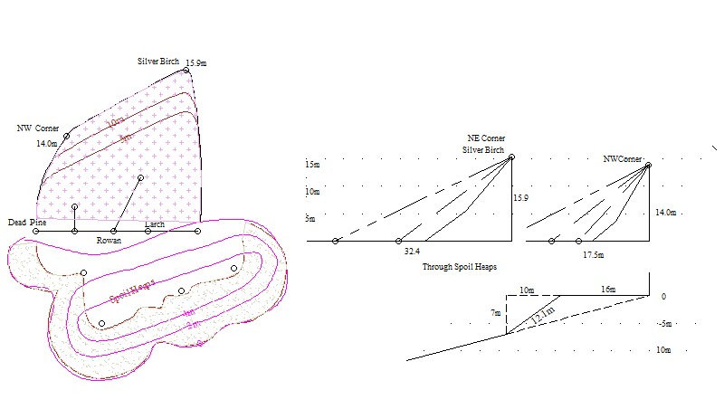
Plan
Section

Slide 23
Results
Material extracted 4000 m3
Spoil heaps 1300 m3
Granite exported 2700 m3
or 8500 T

Slide 24
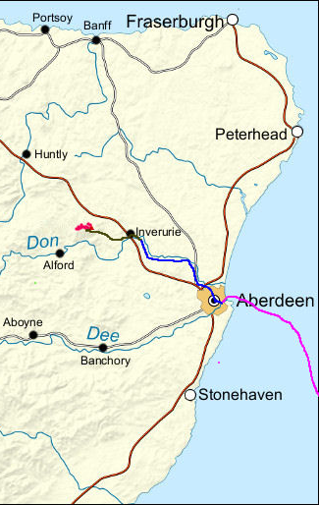
Export to:
bottom of hill 0.5km sledge
Inverurie 10km cart
Aberdeen 26km canal
Sheerness 750km ship

Slide 25
Thank you
from
The Bailies of Bennachie
www.bailiesofbennachie.co.uk

